Slide 1
Machine Learning for Public Policy
Nick Feamster University of Chicago Lecture 7.1: Model Selection and Cross Validation

Slide 2
Model Selection
Biggest question: Does the machine learning algorithm work?
Need to evaluate the quality of models created through algorithms and training.
Key to all evaluation approaches: Never touch the test data!
In practice, this can be a lot harder than it sounds

Slide 3
Problem
Getting the right balance between underfitting and overfitting.
Huge design space for the possibilities of all machine learning models.
Lots of tunable “knobs” (called hyperparameters)
The lambda parameter in regularization of linear regression models
Choice of penalty functions, basis functions, …
The hyperparameters can be tweaked, but it can be hard to figure out what the right setting is because training error isn’t informative.

Slide 4
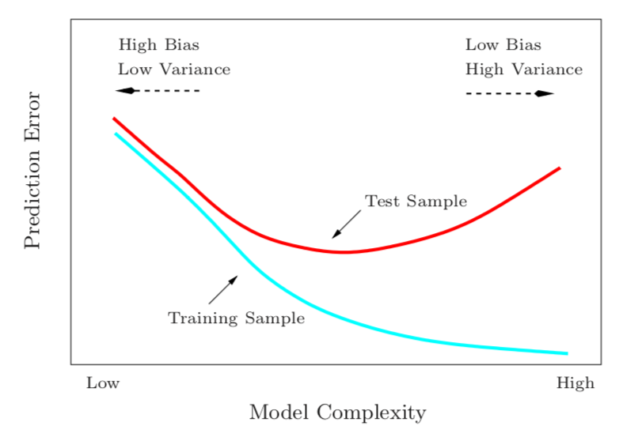
Training Aims to Minimize Error
If our training includes hyper-parameters, then optimization will include over-fitting.
Example: High-degree polynomial expansion.

Slide 5
General Approach: Validation “Hold Out” Set
1. Prepare data: Split data into three sets
Training data: learning/model training
Validation data: For training hyper-parameters
Testing data: only for testing
2. Optimize model on training data
Using training data, optimize model to minimize bias on training set
3. Find optimal hyper-parameters (meta-learning, hyper-parameter optimization)
Use validation data to tune parameters (polynomial degree, loss weight) to minimize error (e.g., MSE) on each validation sample.

Slide 6
How Large Should the Test Set Be?
No fixed rule, but there are some tradeoffs
Test data needs to be large enough to estimate out-of-sample error
Training data needs to be large enough to train the model
Rough Guideline: Error estimation is inversely proportional to the square root of the size of the test set.
Common Approach: 80% Training, 20% Testing

Slide 7






How to Split the Data?
Randomly Split
Split Samples Based on Time

Slide 8








Splitting the Data for Meta-Learning

Slide 9
Overfitting can occur in meta-learning, too!

Slide 10









Solution: Cross-Validation
Goal: Avoid over-fitting to the validation set during meta-learning
Approach: Perform meta-learning using different subsets of the training data for the validation set.
Two general approaches
K-Fold Cross Validation
Leave-One Out Cross-Validation: mostly useful for small datasets

Slide 11
Summary
Machine learning models typically have hyper-parameters that can improve the performance of the models.
Training to optimize both model parameters and hyper-parameters on the training data can result in a model that is overfit.
We can make sure that a model is not overfit by holding out a validation set from the training set

